Slide 1


Jeff Poplin
1/21/2024

Slide 2

Outline
Executive Summary
Introduction
Methodology
Results
Conclusion
Appendix

Slide 3
Executive Summary
Summary of methodologies
The following methods were used to extract, consolidate, analyze and provide predictive analytics for this project.
Data Extraction from the SpaceX API
Data Extraction utilizing web page scraping from Wikipedia
Data Wrangling and cleaning
Data Analysis and Understanding with SQL
Data Visualization with Folium and Dash
Predictive Analytics with Machine Learning

Slide 4
Executive Summary
Summary of all results
67% overall success rate for first stage landings
The success rate continues to improve over time
The GTO orbit had the lowest success rate
Payloadmass, orbit, launch site are some of the key features to predicting success
We can predict future landing outcomes with 80-90 percent accuracy

Slide 5
Introduction
Project background and context
SpaceX advertises Falcon 9 rocket launches on its website, with a cost of 62 million dollars; other providers cost upward of 165 million dollars each, much of the savings is because SpaceX can reuse the first stage. Therefore, if we can determine if the first stage will land, we can determine the cost of a launch.
This project looks to consolidate and analyze data from APIs and Websites to understand what factors correlate wit the outcome of the SpaceX rocket launches. Once the key features are determined and engineered, accurate predictions can be made about future ricket launches.
Problems and questions we are looking to answer
What factors are important in a successful launch
What machine learning models can help us better predict launch outcomes
What is the success rate for future launches

Slide 6

Section 1

Slide 7
Methodology
Executive Summary
Data collection methodology:
Data was extracted from the SpaceX API and the Falcon9 Wikipedia page and saved to CSV files for further exploration
Perform data wrangling
Datasets were processed using Python/Pandas data frame to clean and transform missing data and convert categorical variables to integer values using one hot encoding
Perform exploratory data analysis (EDA) using visualization and SQL
Data was loaded to a database for further analysis using SQL to better understand landing outcomes and get insights on potential input variables

Slide 8
Methodology
Executive Summary
Perform interactive visual analytics using Folium and Plotly Dash
Visualization tools were used to better understand patterns and trends in the rocket launches
Perform predictive analysis using classification models
4 different models were utilized to find the most accurate tool to predict future landing outcomes

Slide 9
Data Collection – SpaceX API
The SpaceX API extraction utilizes multiple requests to join datasets together and load to a pandas data frame for cleansing and transformations
GitHub URL: python/jupyter-labs-spacex-data-collection-api (1).ipynb at main · jpop78/python (github.com)
SpaceX API Extract Workflow
1-Execute requests.get from SpaceX API (rocket launch data) https://api.spacexdata.com/v4/launches/past
2-Convert response json to a dataframe using .json_normalize()
3-Request payload and core data from SpaceX API using functions
4-Filter dataframe to contain only Falcon 9 launches
5-Replace missing values of Payload Mass with calculated .mean()
6-Export data to csv file for later use

Slide 10
Data Collection - Scraping
The Wikipedia data collection utilizes the Beautiful Soup library to parse the site html and load a data frame for analysis
GitHub URL: python/jupyter-labs-webscraping.ipynb at main · jpop78/python (github.com)
Wikipedia Web scraping Workflow
1-Request Falcon 9 launch data from Wikipedia
2-Create BeautifulSoup object from HTML response
3-Extract column names from HTML table header
4-Parse HTML tables
5-Create dictionary and convert to data frame
6-Export data to csv file

Slide 11
Data Wrangling
Data Processing
Read csv file containing launch data into a pandas data frame for wrangling
Look for missing data using df.isnull()
Determine the number of launches for each site using .value_counts
Calculate the number of launches for each type of orbit
Create an integer value column for the outcome label
Use .mean to get the percentage of successful launches
GitHub URL: python/labs-jupyter-spacex-Data wrangling.ipynb at main · jpop78/python (github.com)

Slide 12
EDA with Data Visualization
Scatter Plots - Scatter plots were utilized to see which data points are potentially more correlated to specific landing outcomes
Flight number and payload mass were plotted showing the outcome as colored plots. The higher the payload the less likely the first stage returns
Plotting the launch site and flight number indicated that certain sites had a high success rate and that later flight seemed to be more successful
Bar Charts – good for comparing differences in categories
In comparing Orbit Types with success rates we see the GTO orbit has the lowest success rate and that several orbits have a perfect success rate making this field good for predicting outcomes
Line Chart – great for looking at time series trends
A line chart is used to look at the success rate over time and we see that success increases signifigantly from 2013 on.
GitHub URL: python/jupyter-labs-eda-dataviz.ipynb.jupyterlite.ipynb at main · jpop78/python (github.com)

Slide 13
EDA with SQL
The following results were reported utilizing SQL after importing launch data to a database
• Names of unique launch sites
• A sample of records where launch site begins with ‘CCA’
• The total payload mass carried by boosters launched by NASA
• The average payload mass carried by booster version F9 v1.1
• Date of first successful landing on ground pad
• Names of boosters which had success landing on drone ship with mass greater than 4,000 but less than 6,000
• The total number of successful and failed missions
• Names of booster versions which have carried the max payload
• Failed landing outcomes on drone ship, their booster version and launch site for the months in the year 2015
• The count of landing outcomes between 2010-06-04 and 2017-03-20 order in descending order
GitHub URL: python/jupyter-labs-eda-sql-coursera_sqllite.ipynb at main · jpop78/python (github.com)

Slide 14
Build an Interactive Map with Folium
All launch sites were marked and added to the map
Added a blue circle to indicate NASA Johnson Space Center
Indicted the outcomes for each site, green for success, red for failed
We calculated the distances between a launch site to its proximities.
Answered:
Are launch sites near railways, highways or coastlines.
Do launch sites keep certain distance away from cities.
GitHub URL: python/lab_jupyter_launch_site_location.jupyterlite.ipynb at main · jpop78/python (github.com)

Slide 15
Build a Dashboard with Plotly Dash
We built an interactive dashboard with Plotly dash
We plotted pie charts showing the launch success by launch site
We a plotted scatter chart showing the relationship with Outcome and Payload Mass per booster version.
GitHub URL: python/spacex_dash_app.py at main · jpop78/python (github.com)

Slide 16
Predictive Analysis (Classification)
1- The launch data was first loaded to 2 data frames to get ready for modeling
2- Next, we converted the outcome column into a numpy array stored as a variable Y and scaled the input fields to the same scale
3- The train_test_split function was used to split that data into a training data set and a test set for validation
4-For each of the following classification models we used the GridSearchCV object to test the models with different parameter values to achieve the best accuracy.
Logistic Regression:
Support Vector Machine
Decision Tree
K-Nearest Neighbor
Accuracy was used as the metric for validating our models against the test data set.
We found the best performing classification model to be the decision tree.
GitHub URL: python/SpaceX_Machine_Learning_Prediction_Part_5.jupyterlite.ipynb at main · jpop78/python (github.com)

Slide 17
Results
Exploratory data analysis results
Landing Outcomes have continued to improve over time
There are strong correlations to the landing outcomes based on landing sites, orbit types, and payload mass
Interactive analytics
The launch sites tend to be near the equator, close to the coast, and far enough from highways to prevent launch damage
Predictive analysis results
The decision tree model produced 94% accuracy for predicting landing outcomes on test data

Slide 18

Section 2

Slide 19
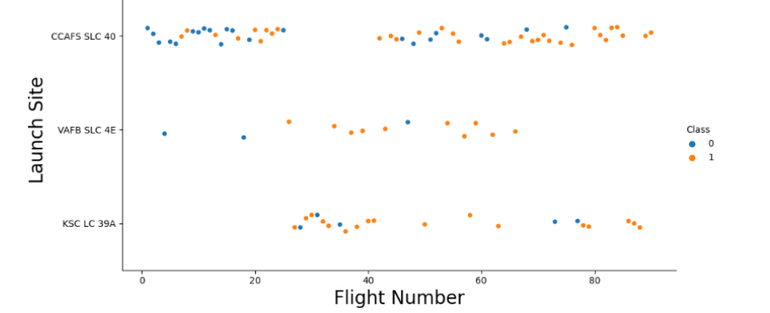
Flight Number vs. Launch Site
The plot shows that later flights had a higher success rate based on a higher rate of orange plots compared to blue
CCAFS SLC 40 had the highest number of launches by far and had a perfect success rate after the 80th launch

Slide 20
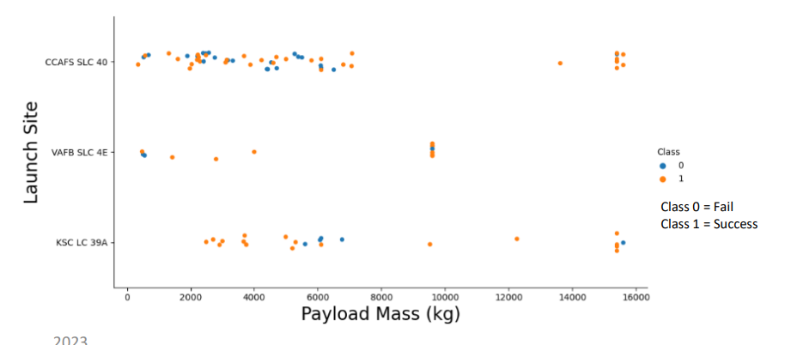
Payload vs. Launch Site
Payloads higher than 8000kg have a very high success rate
VAFB SKC 4E has not launched payloads > 10,000 kg
Most failed launches occurred at a payload between 4,000 and 8,000 kg across all sites

Slide 21
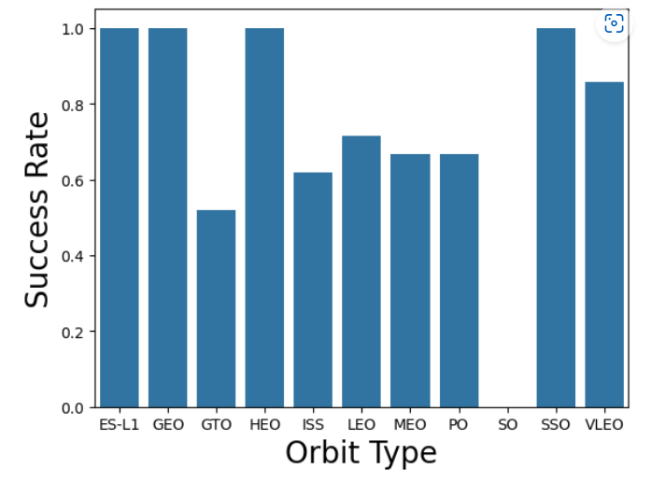
Success Rate vs. Orbit Type
ES-L1, GEO, HEO and SSO have a 100% success rate
SO has a 0% success rate and the remaining are between 50-85%

Slide 22
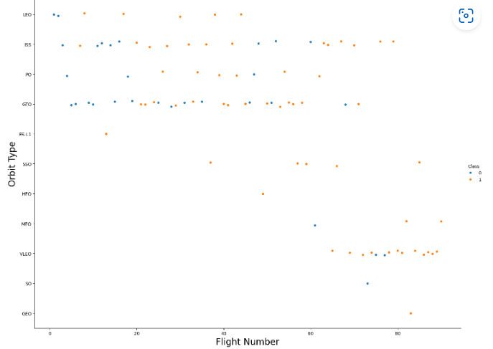
Flight Number vs. Orbit Type
LEO orbit success rate improves over time
The success rate for the GTO orbit does not change over time
The VLEO orbit has a high success rate but did not start launching until after 60 flights

Slide 23
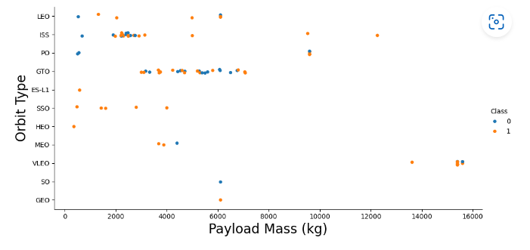
Payload vs. Orbit Type
Polar, LEO and ISS orbits have a high success rate for higher payloads
The GTO orbit has roughly a 50% success rate overall

Slide 24
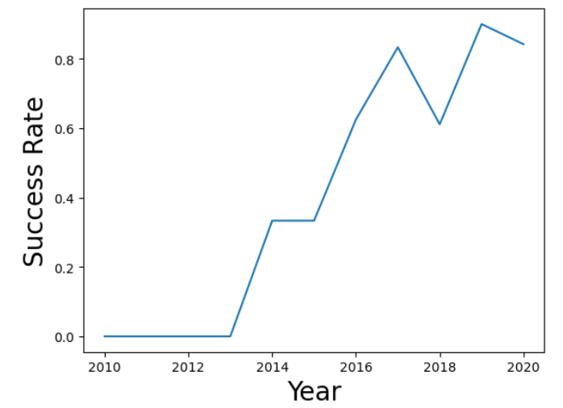
Launch Success Yearly Trend
The time series graph shows that overall, the success rate is improving over time with a significant increase from 2015 to 2017

Slide 25
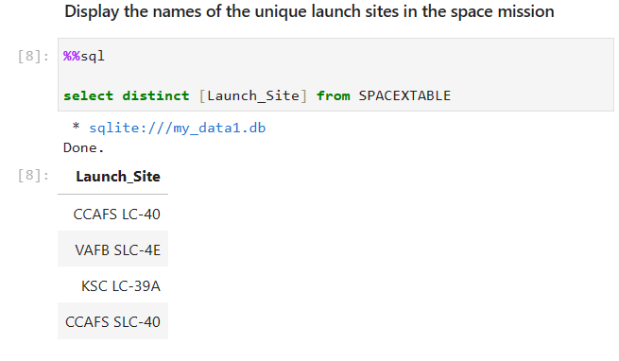
All Launch Site Names
This query gets the distinct list of Launch Sites

Slide 26
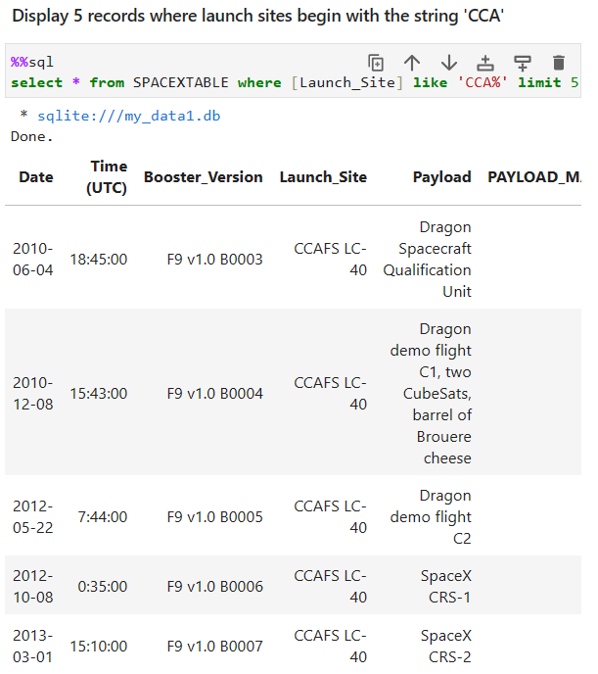
Launch Site Names Begin with 'CCA'
This query limits the results to 5 and displays the launch sites that have the string ‘CCA’ in the name.

Slide 27
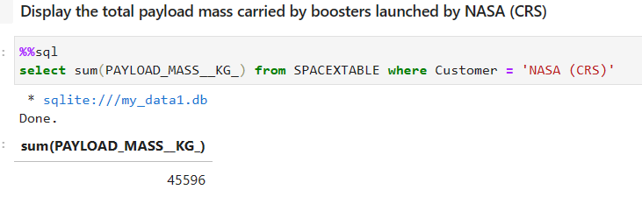
Total Payload Mass
This query gets the sum of the pay load mass for all launches where the customer was NASA (CRS)

Slide 28
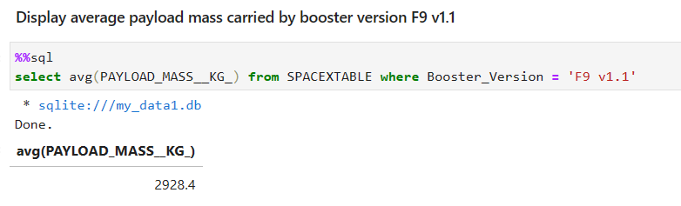
Average Payload Mass by F9 v1.1
This query gets the average payload mass where the booster version equals ‘F9 v1.1’

Slide 29
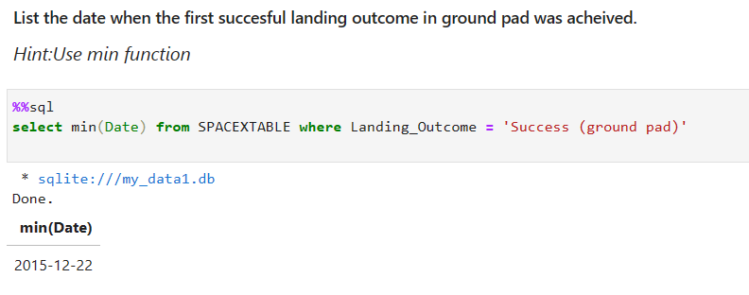
First Successful Ground Landing Date
This query uses the min function to get the earliest date for a success outcome for ground pad

Slide 30
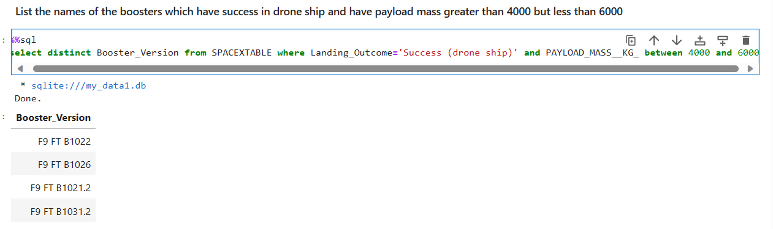
Successful Drone Ship Landing with Payload between 4000 and 6000
This query lists the booster versions with a success on drone ship and payload between 4000 and 6000 kg

Slide 31
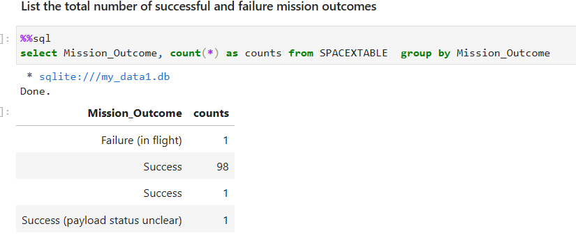
Total Number of Successful and Failure Mission Outcomes
This query lists the counts of the outcomes by grouping by the mission_outcome column

Slide 32
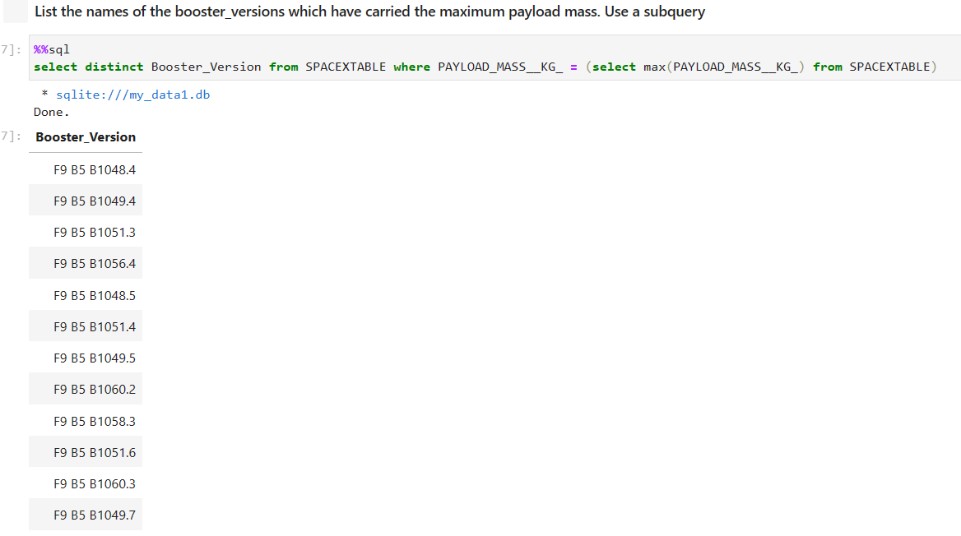
Boosters Carried Maximum Payload
This query gets the list of booster versions that had a payload mass equal to the max payload mass using a sub query to get the maximum payload.

Slide 33
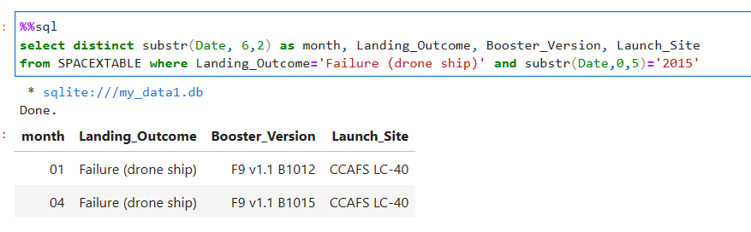
2015 Launch Records
This query uses the substring function to get the month for failed drone ship landings in the year 2015

Slide 34
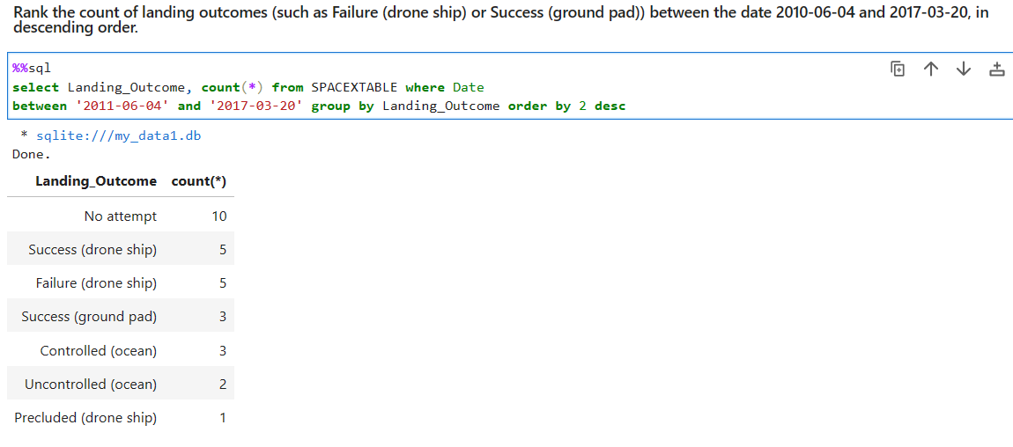
Rank Landing Outcomes Between 2010-06-04 and 2017-03-20
This query gets the counts of launches per landing outcome for a date range and ranks them in descending order

Slide 35

Section 3

Slide 36
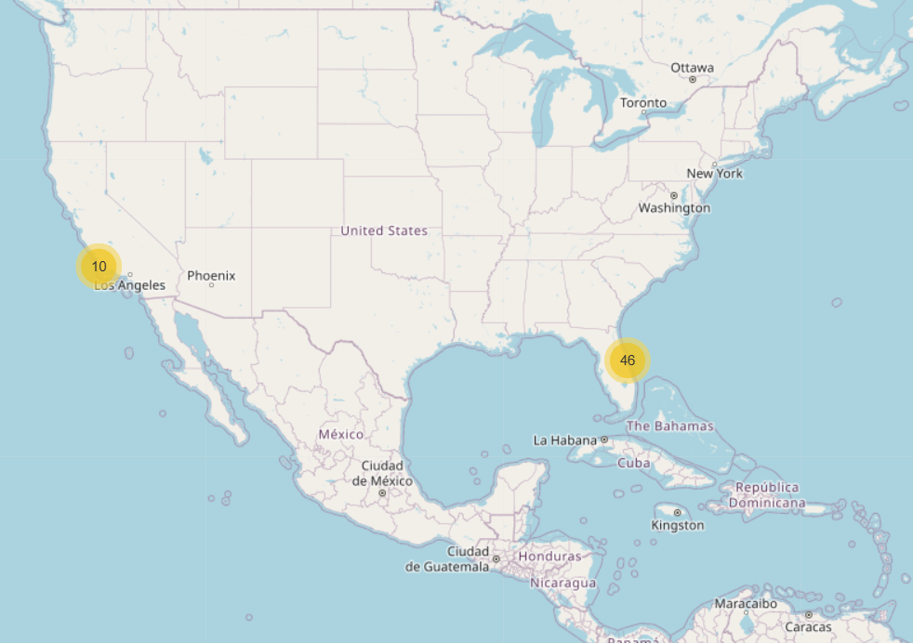
SpaceX Launch Sites
The map shows the launch sites on the east and west coasts in the United States

Slide 37
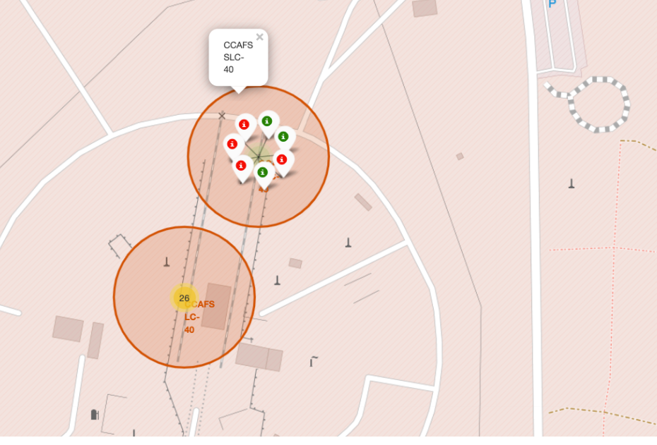
SpaceX Launch Outcomes
As displayed, markers allow the viewer to see the success versus failure outcomes for a given launch site to get an idea of the success rate

Slide 38
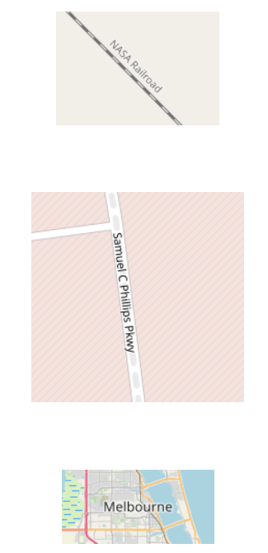
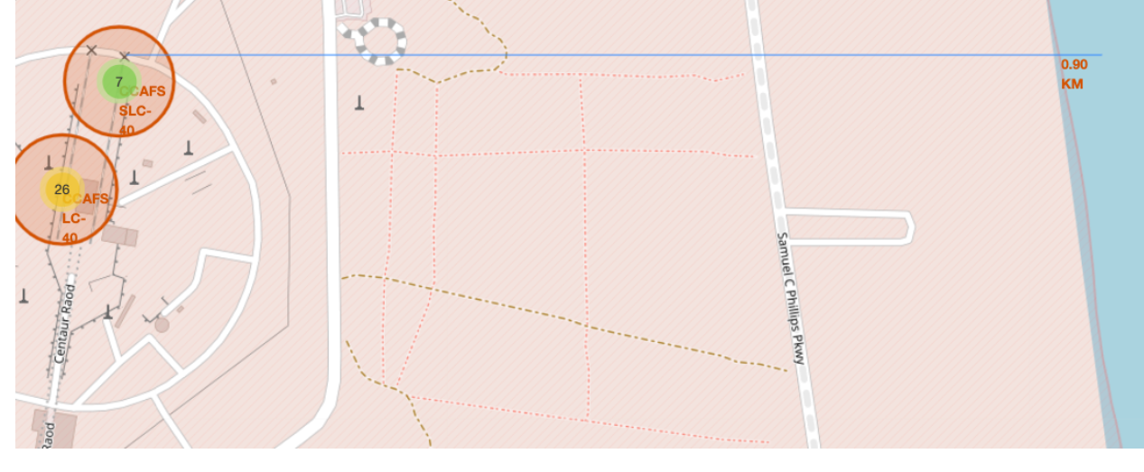
Distance To Proximities
The folium maps allow you to determine distances to railroads, highways, cities and coastlines to see they are far enough away to prevent damage during launches

Slide 39

Section 4

Slide 40
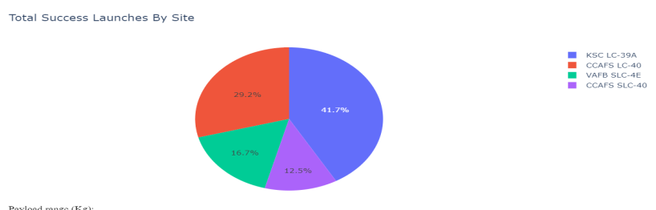
Launch Site Success
This pie chart shows how the different launch sites contributed to the overall successful outcomes

Slide 41
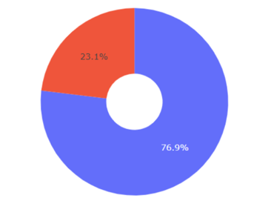
Most Successful Launch Site
KSC LC-39A was the most successful launch site at almost 77 percent success.

Slide 42
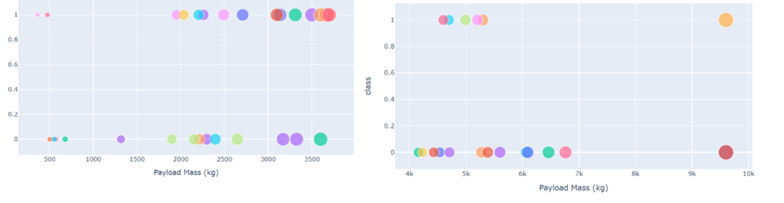
Payload vs Launch Outcome
As we can see the lighter payloads have a higher success rate overall
Light Payload
Heavy Payloads

Slide 43

Section 5

Slide 44
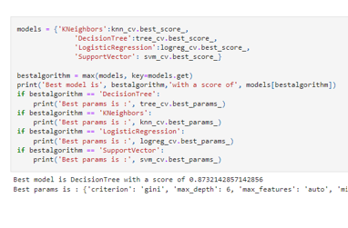
Classification Accuracy
Decision Tree had the best accuracy score

Slide 45
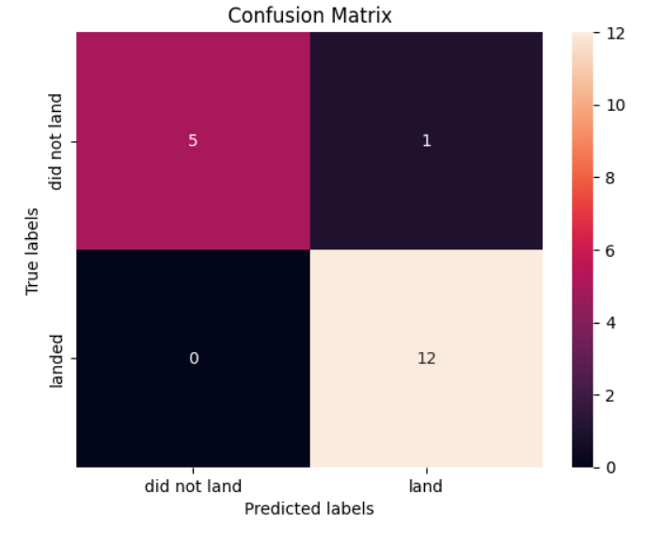
Confusion Matrix
The Decision Tree model provided the best performance of all the models only incorrectly predicting 1 instance.

Slide 46
Conclusions
In concluding our research, we have found the following:
The launches have a higher success rate over time indicting the launch teams are learning from prior launches
There are specific orbits that have a higher success rate and should be studied in more detail.
KSC LC-39A had the most successful lunches and more research should be done with launch site data
All the classification models do well at predicting the outcomes, however the Decision Tree performs the best and should be used going forward.

Slide 47


